Slide 1
Chapter 5 Ethics and Professionalism of IT

Slide 2
Table of Contents
Introduction to Ethics
Introduction to Professional Ethics
Are Computer Experts Professionals?
Software Engineering Code of Ethics
Analysis of the Code
Case Studies

Slide 3
Table of Contents
Whistleblowing
Due Diligence
Personal Responsibility

Slide 4
Introduction to Ethics
Eight Ethical Theories

Slide 5
Introduction to Ethics
Ethics: a way to decide the best thing to do
New problems accompany new technologies
“Common wisdom” may not exist for novel situations brought about by new technologies

Slide 6
Introduction to Ethics - Scenario
Alexis, a good high school student, wants to become a doctor. Because she comes from a poor family, she will need a scholarship in order to attend college. Some of her classes require students to do extra research projects in order to get an A. Her high school has a few older PCs, but there are always long lines of students waiting to use them during the school day. After school, she usually works at a part-time job to help support her family. One evening Alexis visits the library of a private college a few miles from her family’s apartment, and she finds plenty of unused PCs connected to the web. She looks over the shoulder of another student to learn a valid login/password combination. Alexis returns to the library several times a week, and by using its PCs and printers she efficiently completes the extra research projects, graduates from high school with straight A’s, and gets a fullride scholarship to attend a prestigious university.

Slide 7
Introduction to Ethics - Scenario
Did Alexis do anything wrong?
Who benefited from Alexis’s course of action?
Who was hurt by Alexis’s course of action?
Did Alexis have an unfair advantage over her high school classmates?
Would any of your answers change if it turns out Alexis did not win a college scholarship after all?
Are there better ways Alexis could have achieved her objective?
What additional information, if any, would help you answer the previous question?

Slide 8
Introduction to Ethics - Scenario
You are the senior software engineer at a start-up company developing an exciting new product that will allow salespeople to generate and email sales quotes and customer invoices from their smartphones. Your company’s sales force has led a major corporation to believe your product will be available next week. Unfortunately, at this point the package still contains quite a few bugs. The leader of the testing group has reported that all of the known bugs appear to be minor, but it will take another month of testing for his team to be confident the product contains no catastrophic errors. Because of the fierce competition in the smartphone software industry, it is critical that your company be the “first to market.” To the best of your knowledge, a well-established company will release a similar product in a few weeks. If its product appears first, your start-up company will probably go out of business.

Slide 9
Introduction to Ethics - Scenario
Should you recommend release of the product next week?
Who will benefit if the company follows your recommendation?
Who will be harmed if the company follows your recommendation?
Do you have an obligation to any group of people that may be affected by your decision?
What additional information, if any, would help you answer the previous question?

Slide 10
Introduction to Ethics
Ethics: rational, systematic analysis
“Doing ethics”: answers need explanations
Explanations: facts, shared values, logic
Ethics: voluntary, moral choices
Workable ethical theory: produces explanations that might be persuasive to a skeptical, yet open-minded audience

Slide 11
Eight Ethical Theories - 1. Subjective Relativism
Relativism
No universal norms of right and wrong
One person can say “X is right,” another can say “X is wrong,” and both can be right
Subjective relativism
Each person decides right and wrong for himself or herself
“What’s right for you may not be right for me”

Slide 12
Eight Ethical Theories - 1. Subjective Relativism
The Case for Subjective Relativism
Well-meaning and intelligent people can have totally opposite opinions about moral issues.
Ethical debates are disagreeable and pointless.

Slide 13
Eight Ethical Theories – 1. Subjective Relativism
The Case against Subjective Relativism
With subjective relativism the line between doing what you think is right and doing what you want to do is not sharply drawn
By allowing each person to decide right and wrong for himself or herself, subjective relativism makes no moral distinction between the actions of different people

Slide 14
Eight Ethical Theories – 1. Subjective Relativism
The Case against Subjective Relativism
Subjective relativism and tolerance are two different things
We should not give legitimacy to an ethical theory that allows people to make decision based on something other than reason

Slide 15
Eight Ethical Theories – 2. Cultural Relativism
What is “right” and “wrong” depends upon a society’s actual moral guidelines
These guidelines vary from place to place and from time to time
A particular action may be right in one society at one time and wrong in other society or at another time

Slide 16
Eight Ethical Theories – 2. Cultural Relativism
The Case for Cultural Relativism
Different social contexts demand different moral guidelines
It is arrogant for one society to judge another

Slide 17
Eight Ethical Theories – 2. Cultural Relativism
The Case Against Cultural Relativism
Just because two societies do have different views about right and wrong doesn’t imply that they ought to have different views.
Cultural relativism does not explain how an individual determines the moral guidelines of a particular society.
Cultural relativism does not explain how to determine right from wrong when there are no cultural norms.

Slide 18
Eight Ethical Theories – 2. Cultural Relativism
The Case Against Cultural Relativism
Cultural relativism does not do a good job of characterizing actions when moral guidelines evolve.
Cultural relativism provides no framework for reconciliation between cultures in conflict.
The existence of many acceptable cultural practices does not imply that any cultural practice would be acceptable.
Societies do, in fact, share certain core values.
Cultural relativism is only indirectly based on reason.

Slide 19
Eight Ethical Theories – 3. Divine Command Theory
Good actions: those aligned with God’s will
Bad actions: those contrary to God’s will
Holy books reveal God’s will
We should hold holy books as moral decision-making guides

Slide 20
Eight Ethical Theories – 3. Divine Command Theory
The Case for the Divine Command Theory
We owe obedience to our Creator
God is all-good and all-knowing
God is the ultimate authority

Slide 21
Eight Ethical Theories – 3. Divine Command Theory
The Case Against the Divine Command Theory
There are many holy books, and some of their teachings disagree with each other.
It is unrealistic to assume a multicultural society will adopt a religion-based morality.
Some moral problems are not addressed directly in scripture.
It is fallacious to equate “the good” with “God”
The divine command theory is based on obedience, not reason.

Slide 22
Eight Ethical Theories – 4. Ethical Egoism
Each person should focus exclusively on his or her self-interest
Morally right action: that action that provides self with maximum long-term benefit

Slide 23
Eight Ethical Theories – 4. Ethical Egoism
The Case for Ethical Egoism
Ethical egoism is a practical moral philosophy.
It’s better to let other people take care of themselves.
The community can benefit when individuals put their well-being first.
Other moral principles are rooted in the principle of self-interest.

Slide 24
Eight Ethical Theories – 4. Ethical Egoism
The Case against Ethical Egoism
An easy moral philosophy may not be the best moral philosophy.
We do, in fact, know a lot about what is good for someone else.
A self-interested focus can lead to blatantly immoral behavior.
Other moral principles are superior to the principle of self-interest.
People who take the good of others into account live happier lives.

Slide 25
Eight Ethical Theories – 5. Act Utilitarianism
Principle of Utility
Jeremy Bentham and John Stuart Mill
An action is good if it benefits someone
An action is bad if it harms someone
Utility: tendency of an object to produce happiness or prevent unhappiness for an individual or a community
Happiness = advantage = benefit = good = pleasure
Unhappiness = disadvantage = cost = evil = pain

Slide 26
Eight Ethical Theories – 5. Act Utilitarianism
Principle of Utility (Greatest Happiness Principle)
An action is right (or wrong) to the extent that it increases (or decreases) the total happiness of the affected parties.

Slide 27
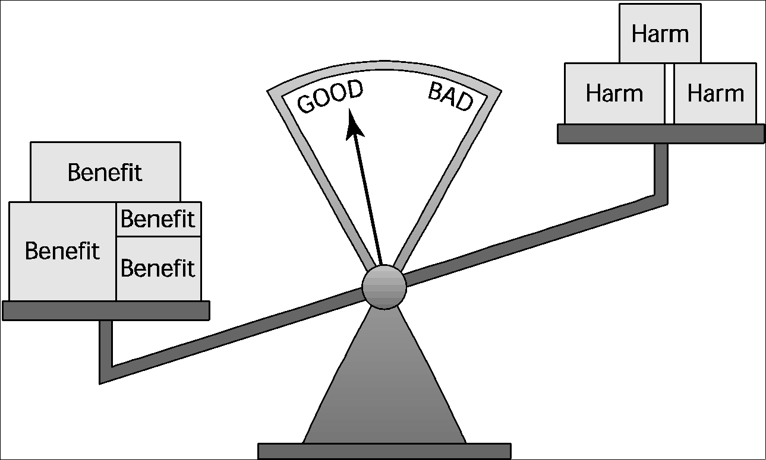
Eight Ethical Theories – 5. Act Utilitarianism
Principle of Utility (Greatest Happiness Principle)
An action is good (or bad) to the extent that it increases (or decreases) the total happiness of the affected parties.

Slide 28
Eight Ethical Theories – 5. Act Utilitarianism
Principle of Utility (Greatest Happiness Principle)
Utilitarianism
Morality of an action has nothing to do with intent
Focuses on the consequences
A consequentialist theory
Act utilitarianism
Add up change in happiness of all affected beings
Sum > 0, action is good
Sum < 0, action is bad

Slide 29
Eight Ethical Theories – 5. Act Utilitarianism
Evaluating a Scenario Using Act Utilitarianism
State may replace a curvy stretch of highway
New highway segment 1 mile shorter
150 houses would have to be removed
Some wildlife habitat would be destroyed

Slide 30
Eight Ethical Theories – 5. Act Utilitarianism
Evaluating a Scenario Using Act Utilitarianism
Bentham proposed seven attributes that can be used to increase or decrease the weight of a particular pleasure or pain:
Intensity
Duration
Certainty
Propinquity
Fecundity
Purity
Extent

Slide 31
Eight Ethical Theories – 5. Act Utilitarianism
Evaluating a Scenario Using Act Utilitarianism
Analysis
Costs
$20 million to compensate homeowners
$10 million to construct new highway
Lost wildlife habitat worth $1 million
Benefits
$39 million savings in automobile driving costs
Conclusion
Benefits exceed costs
Building highway a good action

Slide 32
Eight Ethical Theories – 5. Act Utilitarianism
The Case for Act Utilitarianism
It focuses on happiness
It is down-to-earth
It is comprehensive

Slide 33
Eight Ethical Theories – 5. Act Utilitarianism
The Case against Act Utilitarianism
When performing the utilitarian calculus, it is not clear where to draw the line, yet where we draw the line can change the outcome of our evaluation.
It is not practical to put so much energy into every moral decision.
Act utilitarianism ignores our innate sense of duty.
We cannot predict with certainty the consequences of an action.
Act utilitarianism is susceptible to the problem of moral luck.

Slide 34
Eight Ethical Theories – 6. Rule Utilitarianism
We ought to adopt moral rules which, if followed by everyone, will lead to the greatest increase in total happiness
Act utilitarianism applies Principle of Utility to individual actions
Rule utilitarianism applies Principle of Utility to moral rules

Slide 35
Eight Ethical Theories – 6. Rule Utilitarianism
Evaluating a Scenario using Rule Utilitarianism
August 2003: Blaster worm infected thousands of Windows computers
Soon after, Nachi worm appeared
Took control of vulnerable computer
Located and destroyed copies of Blaster
Downloaded software patch to fix security problem
Used computer as launching pad to try to “infect” other vulnerable PCs

Slide 36
Eight Ethical Theories – 6. Rule Utilitarianism
Evaluating a Scenario using Rule Utilitarianism
Proposed rule: If I can write a helpful worm that removes a harmful worm from infected computers and shields them from future attacks, I should do so
Who would benefit
People who do not keep their systems updated. They would benefit from a worm that automatically remove their network vulnerabilities.
Who would be harmed
People who use networks. Worms make networks less usable by creating a lot of extra network traffic.
People who’s computers are invaded by buggy anti-worms
System administrators. Forcing system administrators to spend more of their time fighting worms.
Conclusion: Harm outweighs benefits. Releasing anti-worm is wrong.

Slide 37
Eight Ethical Theories – 6. Rule Utilitarianism
The Case for Rule Utilitarianism
Not every moral decision requires performing the utilitarian calculus.
Exceptional situations do not overthrow moral rules.
Rule utilitarianism solves the problem of moral luck.
Rule utilitarianism avoids the problem of egocentrism.
It appeals to a wide cross section of society.

Slide 38
Eight Ethical Theories – 6. Rule Utilitarianism
The Case against Utilitarianism in General
Utilitarianism forces us to use a single scale or measure to evaluate completely different kinds of consequences.
All units must be the same in order to do the sum
In certain circumstances utilitarians must quantify the value of a human life

Slide 39
Eight Ethical Theories – 6. Rule Utilitarianism
The Case against Utilitarianism in General
Utilitarianism ignores the problem of an unjust distribution of good consequences.
Utilitarianism does not mean “the greatest good of the greatest number”
That requires a principle of justice
What happens when a conflict arises between the Principle of Utility and a principle of justice?

Slide 40
Eight Ethical Theories – 7. Kantianism
Good will: the desire to do the right thing
Immanuel Kant: Only thing in the world that is good without qualification is a good will
Reason should cultivate desire to do right thing

Slide 41
Eight Ethical Theories – 7. Kantianism
Categorical imperative (First Formulation)
Act only from moral rules that you can at the same time will to be universal moral laws.
Question: Can a person in dire straits make a promise with the intention of breaking it later?
Proposed rule: “I may make promises with the intention of later breaking them.”
The person in trouble wants his promise to be believed so he can get what he needs.
Universalize rule: Everyone may make & break promises
Everyone breaking promises would make promises unbelievable, contradicting desire to have promise believed
The rule is flawed. The answer is “No.”

Slide 42
Eight Ethical Theories – 7. Kantianism
Categorical Imperative (Second Formulation)
Act so that you always treat both yourself and other people as ends in themselves, and never only as a means to an end.
This is usually an easier formulation to work with than the first formulation of the Categorical Imperative.

Slide 43
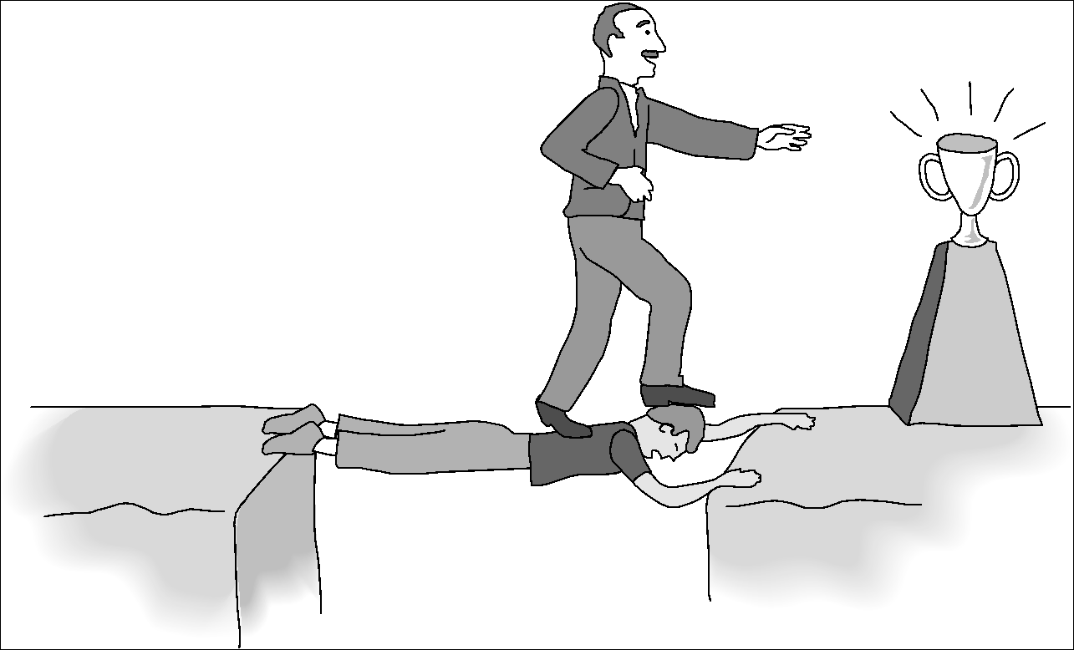
Eight Ethical Theories – 7. Kantianism
Categorical Imperative (Second Formulation)
It is wrong for one person to use himself or another person solely as a means to an end.

Slide 44
Eight Ethical Theories – 7. Kantianism
Evaluating a scenario using Kantianism
Carla
Single mother
Works full time
Takes two evening courses/semester
History class
Requires more work than normal
Carla earning an “A” on all work so far
Carla doesn’t have time to write final report
Carla purchases report and submits it as her own work

Slide 45
Eight Ethical Theories – 7. Kantianism
Evaluating a scenario using Kantianism – 1st Formulation
Carla wants credit for plagiarized report
Rule: “You may claim credit for work performed by someone else”
If rule universalized, reports would no longer be credible indicator’s of student’s knowledge, and professors would not give credit for reports
Proposal moral rule is self-defeating
It is wrong for Carla to turn in a purchased report

Slide 46
Eight Ethical Theories – 7. Kantianism
Evaluating a scenario using Kantianism – 2nd Formulation
Carla submitted another person’s work as her own
She attempted to deceive professor
She treated professor as a means to an end
End: passing the course
Means: professor issues grade
What Carla did was wrong

Slide 47
Eight Ethical Theories – 7. Kantianism
The Case for Kantianism
Kantianism is rational
Kantianism produces universal moral guidelines.
All persons are treated as moral equals.

Slide 48
Eight Ethical Theories – 7. Kantianism
The Case against Kantianism
Sometimes no single rule fully characterizes an action.
Sometimes there is no way to resolve a conflict between rules.
Kantianism allows no exceptions to perfect duties.

Slide 49
Eight Ethical Theories – 8. Social Contract Theory
Thomas Hobbes
“State of nature”
We implicitly accept a social contract
Establishment of moral rules to govern relations among citizens
Government capable of enforcing these rules
Jean-Jacques Rousseau
In ideal society, no one above rules
That prevents society from enacting bad rules

Slide 50
Eight Ethical Theories – 8. Social Contract Theory
James Rachels’s Definition:
“Morality consists in the set of rules, governing how people are to treat one another, that rational people will agree to accept, for their mutual benefit, on the condition that others follow those rules as well.”

Slide 51
Eight Ethical Theories – 8. Social Contract Theory
Negative right: A right that another can guarantee by leaving you alone
Positive right: A right obligating others to do something on your behalf
Absolute right: A right guaranteed without exception
Limited right: A right that may be restricted based on the circumstances

Slide 52
Eight Ethical Theories – 8. Social Contract Theory
Positive rights tend to be more limited
Negative rights tends to be more absolute

Slide 53
Eight Ethical Theories – 8. Social Contract Theory
John Rawls’s Principles of Justice
Each person may claim a “fully adequate” number of basic rights and liberties, so long as these claims are consistent with everyone else having a claim to the same rights and liberties
Any social and economic inequalities must
Be associated with positions that everyone has a fair and equal opportunity to achieve
Be to the greatest benefit of the least-advantaged members of society (the difference principle)

Slide 54
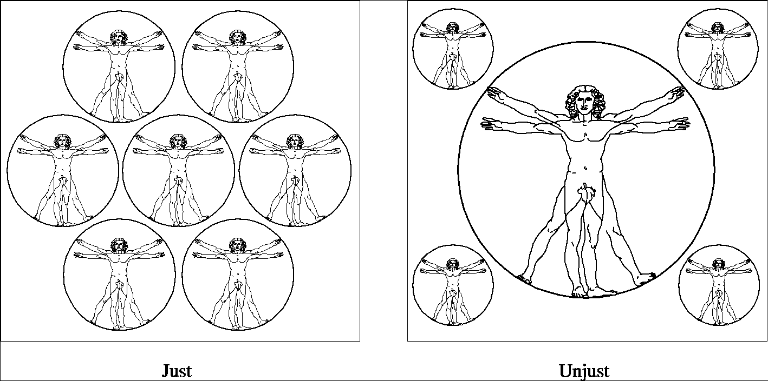
Eight Ethical Theories – 8. Social Contract Theory
John Rawls’s Principles of Justice
Rawls’s first principle of justice states that each person may have a “fully adequate” number of rights and liberties as long as they are consistent with everyone else having the same rights and liberties.

Slide 55
Eight Ethical Theories – 8. Social Contract Theory
John Rawls’s Principles of Justice
Suppose both of these income tax structures will produce the same income to the government. Under Plan A, every citizen pays $5,000; under Plan B, the amount each citizen pays depends upon his or her income. Plan B does not treat every citizen equally, but the inequality is justified under Rawls’s difference principle because it is of greatest benefit to the most disadvantaged.

Slide 56
Eight Ethical Theories – 8. Social Contract Theory
Evaluating a Scenario Using Social Contract Theory
Bill owns chain of DVD rental stores
Collects information about rentals from customers
Constructs profiles of customers
Sells profiles to direct marketing firms
Some customers happy to receive more mail order catalogs; others unhappy at increase in “junk mail”

Slide 57
Eight Ethical Theories – 8. Social Contract Theory
Evaluating a Scenario Using Social Contract Theory
Analysis
Consider rights of Bill, customers, and mail order companies.
Does customer have right to expect name, address to be kept confidential?
If customer rents DVD from bill, who owns information about transaction?
If Bill and customer have equal rights to information, Bill did nothing wrong to sell information.
If customers have right to expect name and address or transaction to be confidential without giving permission, then Bill was wrong to sell information without asking for permission.

Slide 58
Eight Ethical Theories – 8. Social Contract Theory
The Case for Social Contract Theory
It is framed in the language of rights
It explains why rational people act out of self-interest in the absence of a common agreement.
It provides a clear ethical analysis of some important moral issues regarding the relationship between people and government.

Slide 59
Eight Ethical Theories – 8. Social Contract Theory
The Case against Social Contract Theory
None of us signed the social contract.
Some actions can be characterized in multiple ways.
Social contract theory does not explain how to solve a moral problem when the analysis reveals conflicting rights.
Social contract theory may be unjust to those people who are incapable of upholding their side of the contract.

Slide 60
Introduction to Professional Ethics

Slide 61
Introduction to Professional Ethics
Informally, profession a vocation requiring:
High level of education
Practical experience
We pay professionals well
Doctors
Lawyers
We trust professionals to…
Correctly ascertain and treat problems
Take actions for the good of their clients

Slide 62
Introduction to Professional Ethics
For IT:
Moral decisions made by people who design, implement, or maintain computer hardware or software systems

Slide 63
Are Computer Experts Professionals?
Characteristics of a Profession
Computer-Related Careers

Slide 64
Characteristics of a Profession
Initial professional education – formal course work completed by candidates before they begin practicing the profession
Accreditation – assures that the formal course work meets the standards of the profession
Skills development – activities that provide candidates with the opportunity to gain practical skills needed to practice the profession
Certification – process by which candidates are evaluated to determine their readiness to enter the profession
Are Computer Experts Professionals?

Slide 65
Characteristics of a Profession
Licensing- the process giving candidates the legal right to practice the profession
Professional development – formal course work completed by professionals in order to maintain and develop their knowledge and skills
Code of ethics – mechanism by which a profession ensures that its members will use their knowledge and skills for the benefit of society
Professional society – organization promoting the welfare of the profession, typically consisting of most if not all of the members of the profession
Are Computer Experts Professionals?

Slide 66
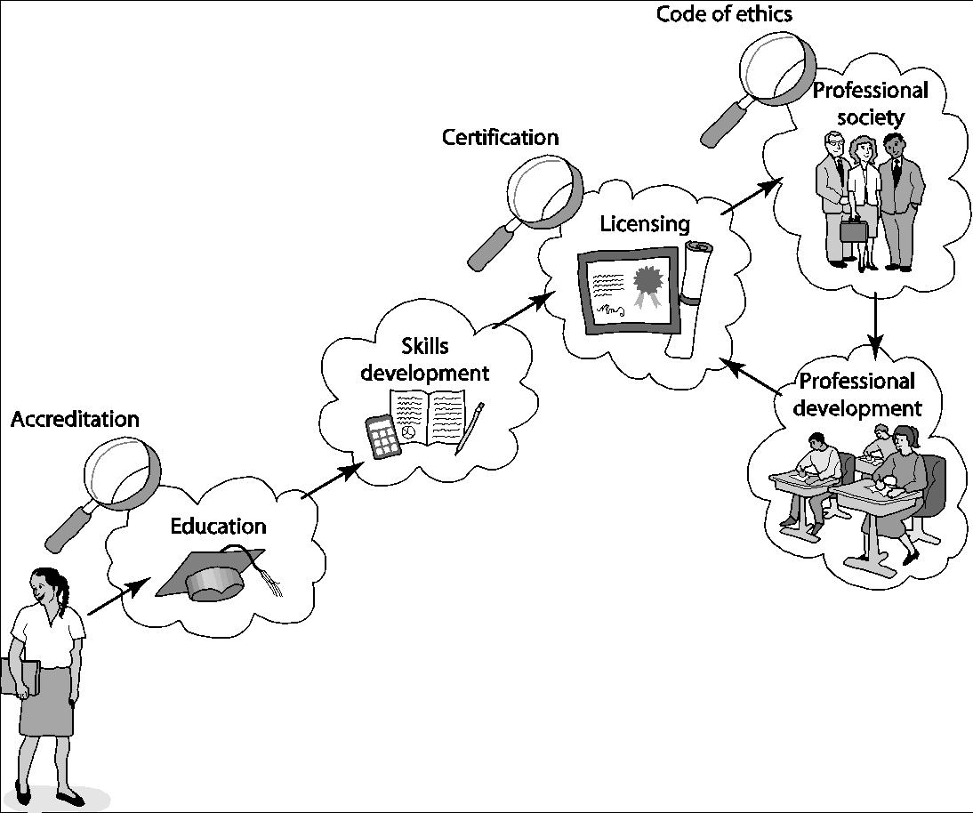
Characteristics of a Profession
A mature profession has eight attributes that enable it to certify new members and support existing members

Slide 67
Computer-Related Careers
Certification and licensing not required
College degree not required
Apprenticeship not required
Membership in professional society optional
No specific requirements for continuing education
Most computer programmers, system analysts, etc. are part of teams
Ability to harm public can be similar to members of mature professions
Are Computer Experts Professionals?

Slide 68
Software Engineering Code of Ethics
Preamble
Principles

Slide 69
Preamble
The Software Engineering Code of Ethics and Professional Practice (Software Engineering Code of Ethics, in short) is a practical framework for moral decision-making related to problems that software engineers may encounter.
The Software Engineering Code of Ethics and Professional Practice produced under Association of Computing Machinery (ACM) publication.
Software Engineering Code of Ethics

Slide 70
Preamble
Software engineers have opportunities to do good or do harm
Software engineers ought to be committed to doing good
Eight principles identify key ethical relationships and obligations within these relationship
Code should be seen as a whole, not a collection of parts
Concern for the public interest is paramount
Software Engineering Code of Ethics

Slide 71
Principles
Public: act consistently with the public interest
Client and employer: act in a manner that is in the best interests of their client and employer, consistent with the public interest
Product: ensure that their products and related modifications meet the highest professional standards possible
Judgment: maintain integrity and independence in their professional judgment
Software Engineering Code of Ethics

Slide 72
Principles
Management: subscribe to and promote an ethical approach to the management of software development and maintenance
Profession: advance the integrity and reputation of the profession consistent with the public interest
Colleagues: fair to and supportive of their colleagues
Self: participate in lifelong learning regarding the practice of their profession and shall promote an ethical approach to the practice of the profession
Software Engineering Code of Ethics

Slide 73
Principles
PRINCIPLE 1: PUBLIC
1.01 “Accept full responsibility for own work”
1.02 Balance competing interests
1.03 Approve software only if it is safe
1.04 Disclose actual/potential dangers
1.05 “Cooperate in efforts to address” public concerns
1.06 “Be fair and avoid deception in all statements”
1.07 Consider factors that diminish access to software
1.08 “Volunteer professional skills to good causes”
Software Engineering Code of Ethics

Slide 74
Principles
PRINCIPLE 2: CLIENT AND EMPLOYER
2.01 Act within areas of competence
2.02 Don’t use software obtained illegally
2.03 Only use property in authorized ways
2.04 Ensure documents are approved
2.05 Respect confidentiality
2.06 Promptly report problems with project
2.07 Report issues of social concern
2.08 Refuse outside work detrimental to job
2.09 Put employer’s/client’s interests first, unless overriding moral concern
Software Engineering Code of Ethics

Slide 75
Principles
PRINCIPLE 3: PRODUCT
3.01 Aim for “high quality, acceptable cost and a reasonable schedule,” making trade-offs clear
3.02 “Ensure proper and achievable goals”
3.03 Face up to “ethical, economic, cultural, legal and environmental” issues
3.04 Ensure you are qualified for proposed work
3.05 Use appropriate project methodologies
3.06 Follow the most appropriate professional standards
3.07 “Strive to fully understand the specifications”
3.08 Ensure the specifications are correct and approved
Software Engineering Code of Ethics

Slide 76
Principles
PRINCIPLE 3: PRODUCT
3.09 “Ensure realistic quantitative estimates of cost, scheduling, personnel, quality and outcomes”
3.10 “Ensure adequate testing, debugging, and review of software and related documents”
3.11 “Ensure adequate documentation”
3.12 Develop software and documents that respect privacy of those affected by software
3.13 Use only accurate data appropriately acquired
3.14 Maintain data integrity
3.15 Use same standards for software maintenance as software development
Software Engineering Code of Ethics

Slide 77
Principles
PRINCIPLE 4: JUDGMENT
4.01 “Temper all technical judgments by the need to support and maintain human values”
4.02 Understand and agree with documents before endorsing them
4.03 Remain objective when evaluating software or related documents
4.04 Do not engage in deceptive financial practices
4.05 Disclose conflicts of interest
4.06 Do not participate in decisions in which you, your employer, or your client has a potential conflict of interest
Software Engineering Code of Ethics

Slide 78
Principles
PRINCIPLE 5: MANAGEMENT
5.01 Ensure good project management procedures
5.02 Ensure software engineers know standards
5.03 Ensure software engineers know policies and procedures for protecting confidential information
5.04 Take employees’ abilities into account before assigning work
5.05 Ensure reasonable estimates are made
5.06 Give full and accurate information to potential employees
Software Engineering Code of Ethics

Slide 79
Principles
PRINCIPLE 5: MANAGEMENT
5.07 Pay employees fairly
5.08 Do not unjustly prevent a qualified person from taking a job
5.09 Work out fair intellectual property agreements
5.10 Provide employees charged with misconduct due process
5.11 Do not ask someone to do anything violating the Code
5.12 “Do not punish anyone for expressing ethical concerns about a project”
Software Engineering Code of Ethics

Slide 80
Principles
PRINCIPLE 6: PROFESSION
6.01 Help create an environment supporting ethical conduct
6.02 “Promote public knowledge of software engineering”
6.03 Participate in professional activities
6.04 Support others who are trying to follow this Code
6.05 Do not promote self-interest at expense of profession, client, or employer
6.06 Obey all laws unless there is an overriding public interest
6.07 Do not deceive others regarding the characteristics of software
Software Engineering Code of Ethics

Slide 81
Principles
PRINCIPLE 6: PROFESSION
6.08 Take responsibility for finding, correcting, and reporting errors in software and documentation
6.09 Ensure others know you are committed to the Code and what that means
6.10 Do not associate with businesses and organizations that are in conflict with Code
6.11 Understand violating the Code is inconsistent with being a professional
6.12 Share concerns about Code violations with the people involved
6.13 “Blow the whistle” when no alternative to reporting significant Code violations
Software Engineering Code of Ethics

Slide 82
Principles
PRINCIPLE 7: COLLEAGUES
7.01 “Encourage colleagues to adhere to this Code”
7.02 “Assist colleagues in professional development”
7.03 Give others the credit they deserve
7.04 Be objective when reviewing the work of others
7.05 Give colleagues a fair hearing
7.06 Help colleagues remain aware of work practices
7.07 Do not unfairly interfere with another’s career, but protect the public interest
7.08 Bring in experts for situations outside your own area of competence.
Software Engineering Code of Ethics

Slide 83
Principles
PRINCIPLE 8: SELF
8.01 Stay current with developments in field
8.02 Improve ability to create high quality software
8.03 Improve ability to produce high quality documentation
8.04 Improve understanding of software and documentation used in work
8.05 Improve knowledge of relevant standards
8.06 Improve knowledge of this Code and its application
8.07 Do not treat others unfairly because of prejudices
8.08 Do not influence others to break the Code
8.09 “Recognize that personal violations of this Code are inconsistent with being a professional software engineer”
Software Engineering Code of Ethics

Slide 84
Analysis of the Code
Preamble
Virtue Ethics
Alternative List of Fundamental Principles

Slide 85
Preamble
No mechanical process for determining if an action is right or wrong
Should not take an overly legalistic view of the Code
If Code doesn’t forbid something, that doesn’t mean it is morally acceptable
Judgment required
Code reflects principles drawn from multiple ethical theories
Analysis of the Code

Slide 86
Virtue Ethics
Aristotle
Happiness results from living a life of virtue
Intellectual virtue: developed through education
Moral virtue: developed by repeating appropriate acts
Deriving pleasure from a virtuous act is a sign that the virtue has been acquired
Analysis of the Code

Slide 87
Virtue Ethics
Some virtues: Benevolence, courage, fairness, generosity, honesty, loyalty, patience, tolerance
A person of strong moral character
possesses many virtues
knows right thing to do in each situation
Analysis of the Code

Slide 88
Virtue Ethics
Strengths of Virtue Ethics
Provides a motivation for good behavior
Provides a solution to the problem of impartiality
Some virtues are partial (e.g., generosity)
Other virtues must be impartial (e.g., honesty)
Analysis of the Code

Slide 89
Virtue Ethics
Virtue Ethics complements other theories
Virtue ethics may not work as a stand-alone theory
It may be a good complement to utilitarianism
Allows rationale for action to be considered
Solves problem of moral luck that plagued act utilitarianism
Analysis of the Code

Slide 90
Alternative List of Fundamental Principles
Be impartial.
Disclose information that others ought to know.
Respect the rights of others.
Treat others justly.
Take responsibility for your actions and inactions.
Take responsibility for the actions of those you supervise.
Maintain your integrity.
Continually improve your abilities.
Share your knowledge, expertise, and values.
Analysis of the Code

Slide 91
Case Studies
Software Recommendation
Child Pornography
Anti-Worm
Consulting Opportunity

Slide 92
Case: Software Recommendation
Sam Shaw asks for free advice on LAN security
Prof. Smith answers questions and recommends top-ranked package
Prof. Smith does not disclose
She has financial interest in company producing top-ranked package
Another package was given a “best buy” rating
Did Prof. Smith do anything wrong?

Slide 93
Case: Software Recommendation
Analysis
Most relevant principles
Be impartial.
Disclose information others ought to know.
Share your knowledge, expertise, and values.
Clause 1.06: Prof. Smith was deceptive
Clauses 1.08, 6.02: Prof. Smith freely gave valuable information
Clauses 4.05, 6.05: Prof. Smith did not reveal conflict of interest

Slide 94
Case: Software Recommendation
Conclusion
Professor Smith should have revealed her conflict of interest to Mr. Shaw.

Slide 95
Case: Child Pornography
Joe Green a system administrator
Asked to install new software package on Chuck Dennis’s computer
Green not authorized to read other people’s emails or personal files
Green sees suspicious-looking file names
He opens some of Dennis’s files and discovers child pornography
What should he do?

Slide 96
Case: Child Pornography
Analysis
Most relevant principles
Be impartial
Respect the rights of others
Treat others justly
Maintain your integrity

Slide 97
Case: Child Pornography
Analysis
Most relevant clauses
2.03: Somebody has misused the company PC
2.09: Someone is using the PC for a purpose not in the employer’s interest
3.13: Joe violated the policy against opening files
5.10: Someone else may have planted the files on Chuck’s computer

Slide 98
Case: Child Pornography
Conclusion
Joe was wrong to violate company policy to uncover child pornography
Once he has this knowledge, however, he is obliged to share it with company authorities
Joe should be discreet

Slide 99
Case: Anti-Worm
Internet plagued by new worm that exploits hole in popular operating system
Tim Smart creates anti-worm that exploits same security hole
Tim’s anti-worm fixes PCs it infects. It also uses these PCs as launch pad to reach new PCs.
Tim launches anti-worm, taking pains to keep it from being traced back to him.
The anti-worm quickly spreads through Internet, infecting millions of computers
System administrators around the world combat the anti-worm

Slide 100
Case: Anti-Worm
Analysis
Most relevant principles
Continually improve your abilities.
Share your knowledge, expertise, and values.
Respect the rights of others.
Take responsibility for your actions and inactions.

Slide 101
Case: Anti-Worm
Analysis
Most relevant clauses:
1.01: Tim did not accept responsibility for his action.
1.08: The worm was free, but cost system administrators a lot of time.
2.03: The anti-worm entered computers without permission of their owners.
8.01, 8.02, 8.06: Tim improved his knowledge and skills by creating the anti-worm.

Slide 102
Case: Anti-Worm
Conclusion
Tim’s welfare is less important than the public good
By attempting to hide his identity, Tim refused to accept responsibility for his actions
Tim violated the property rights of the PC owners whose systems were infected by his anti-worm
Tim violated the Code

Slide 103
Case: Consulting Opportunity
Jean works in support organization for Acme Corporation
Many Acme customers downgrading their level of support
East Dakota gives Jean opportunity to run a training class similar to that provided by Acme
Jean tells no one at Acme
Jean develops materials at home on own time
Jean takes paid vacation to teach class

Slide 104
Case: Consulting Opportunity
Analysis
Most relevant principles
Be impartial.
Take responsibility for your actions and inactions.
Disclose information that others ought to know.
Maintain your integrity.
Continually improve your abilities.

Slide 105
Case: Consulting Opportunity
Analysis
Most relevant clauses
3.04: Jean was well qualified to develop materials and teach class
8.04: By creating materials, Jean became even more familiar with Acme’s package and its capabilities
4.05: Jean didn’t disclose his conflict of interest with his employer
2.08: Jean deprived himself of “time off” needed to do his best work at Acme
6.05: Jean put his own interest above that of his employer

Slide 106
Case: Consulting Opportunity
Conclusion
Jean did not disclose East Dakota’s offer or his decision to Acme’s management
Acme’s management is likely to question Jean’s loyalty to the company
Jean’s actions were wrong and unwise

Slide 107
Whistleblowing
Morton Thiokol/NASA
Hughes Aircraft
Morality of Whistleblowing

Slide 108
Whistleblowing
Whistleblower
Tries to report harmful situation through authorized channels
Discouraged by organization
Makes disclosure through unauthorized channels
Whistleblowers punished for their actions
Lose job or all chances of advancement
Financial and emotional hardship
False Claims Act
Whistleblower Protection Act

Slide 109
Case: Morton Thiokol/NASA
Challenger explosion
Roger Boisjoly and Morton Thiokol engineers documented dangers of low-temperature launches
Morton Thiokol executives and NASA officials overrode and hid concerns
Boisjoly shared information with Presidential commission
Morton Thiokol retaliated
Boisjoly took medical leave for stress, then quit
Found job as a consultant two years later

Slide 110
Case: Hughes Aircraft
Factory for military-grade hybrid chips
Some defective chips being approved
Margaret Goodearl and Ruth Ibarra reported incidents to upper management
Consequences for Goodearl
Harassed
Fired
Unemployment
Bankruptcy
Divorce
Margaret Goodearl and Ruth Ibarra sued Hughes Aircraft under False Claims Act and won
Notes:
Margaret Goodearl and Ruth Ibarra are the two whistleblower in our case. Goodearl was in charge (along with Donald LaRue) of the floor area in which the testing was done. Ibarra was a quality control agent hired by the company to provide an additional audit of the accuracy and completeness of the tests.
The decision to blow the whistle
After Goodearl began to report the incident internally to upper management, Goodearl's performance reviews took a sharp drop. Her earlier reviews had been excellent and she had been promoted to her current position because of them. The feedback she was getting from upper management was clear, she had to shut up and get with the team, or lose her job.
Just before the AMRAAM incident, Goodearl and Ibarra, knowing that the series of incidents was likely to continue, placed a telephone call to the Fraud Hotline of the Office of the Inspector General. After several telephone conversations and face to face meetings, they agreed to begin to look for clear evidence of fraud. After the AMRAAM incident, Goodearl was laid off. Ruth Ibarra was transferred to another position that involved loss of most of her responsibility. She later left Hughes.
Court Battles
The Inspector General's office began an investigation in 1989, as soon as they received the clear evidence from the AMRAAM incident.
After Goodearl was laid of by Hughes in 1989, she filed a Wrongful Discharge suit against them. In 1990, Goodearl dropped this suit in favor of what is called a qui tam lawsuit in cooperation with Ruth Ibarra (now married with the last name Aldred). The two whistleblowers claimed in their suit that Hughes was defrauding the Government in its microcircuit testing procedures. Specifically, the civil suit charged Hughes with "knowingly presenting, or causing to be presented, false or fraudulent claims against the United states, or knowingly making, using, or causing to be made or used, a false record or statement to get a false or fraudulent claim allowed or paid by the Government, and for conspiring to defraud the Government by getting a false or fraudulent claim allowed or paid, in violation of the False Claims Act, 31 U.S.C. §§ 3729-32."
The False Claims Act has been around since 1983, and was designed to allow a citizen to sue a U.S. government contractor for making false of fraudulent claims about the quality of the goods or services the contractor has agreed to provide. It allows the citizen to sue "on behalf of" the government (thus the Latinqui tam). The person suing can recover personally up to 25% of whatever damages are eventually assessed. The bulk of the damages go to reimburse the U.S. government.
Goodearl and (now) Aldred filed the civil qui tamsuit because they felt the Inspector General's office was too slow in its own investigation. But in 1991, the Department of Defense charged Hughes in criminal court with willfully conspiring to defraud the Government. The charges were defrauding the DoD by "knowingly and deliberately producing hybrids that had not been tested in the manner specified by contract and the pertinent military specifications…and to make false statements, writings and representations on documents in a matter within the jurisdiction of the DoD."
The civil lawsuit was put on hold while the criminal accusations were settled. The criminal trial lasted a month. Hughes' lawyers constantly battered at the credibility of the two main witnesses, Goodearl and Aldred. They claimed that the only fraud that had been committed was the AMRAAM incident, and that all the other incidents were distorted by Goodearl and Aldred, and the Department of Defense. It was a difficult and ugly proceeding, especially for Goodearl and Aldred.
Outcomes
On June 15th, 1992, Hughes was found guilty of conspiring to defraud the government. Donald LaRue, who had also been charged, was found not guilty. Comments by the jury suggest that they felt LaRue had himself been pressured into his actions, and that the company was to blame.
After being found guilty in criminal court, and after an unsuccessful attempt to appeal, Hughes began to negotiate in the civil suit. They agreed to a settlement in 1996. Hughes was assessed 4.05 million for their fraud. Goodearl and Aldred were awarded $891,000 of this amount (22%). Hughes also had to pay the legal fees for Goodearl and Aldred ($450,000).
Both Goodearl and Aldred were profoundly affected by their decision to blow the whistle, and by Hughes retaliation. Goodearl and her husband had to file for bankruptcy, and Aldred was on welfare for a year before she could find another job. Goodearl's marriage eventually broke up. Still, both felt they had been correct in blowing the whistle. After the final settlement, Aldred said, "Despite the toll it has taken, it was the right thing to do."

Slide 111
Morality of Whistleblowing
People become whistleblowers for different reasons
Morality of action may depend on motives
Good motive
Desire to help the public
Questionable motives
Retaliation
Avoiding punishment

Slide 112
Morality of Whistleblowing
Corporate response to whistleblowing
Whistleblowers are disloyal
Whistleblowing has many harms
Bad publicity
Disruption of organization’s social fabric
Makes it hard for people to work as team
If company causes harm, public can use legal remedies to seek damages
Critique: Overly legalistic view of public harm?

Slide 113
Morality of Whistleblowing
Whistleblowing is a sign of organizational failure
Whistleblowing harms organization
Bad publicity
Ruined careers
Erodes team spirit
Whistleblowing harms whistleblower
Retaliation
Estrangement

Slide 114
Morality of Whistleblowing
Whistleblowing is a sign of organizational failure
Organizations should improve communication
Critique
Is this realistic?
Robert Spitzer: Organizations should return to using principle-based ethics in decision making

Slide 115
Morality of Whistleblowing
Whistleblowing as a moral duty
Richard DeGeorge’s questions for whistleblowing
Is serious harm to the public at stake?
Have you told your manager?
Have you tried every possible inside channel?
Do you have persuasive documented evidence?
Are you sure whistleblowing will work?

Slide 116
Morality of Whistleblowing
Whistleblowing as a moral duty
Under what conditions must you blow the whistle?
DeGeorge: If all five conditions are met
Others: If conditions 1-3 are met
Still others: Whistleblowing is never morally required

Slide 117
Morality of Whistleblowing
Whistleblowing as a moral duty
Exclusive Responsibilities
Role responsibility
Causal responsibility
Legal responsibility
Moral responsibility
Must be borne by people
Is not exclusive

Slide 118
Morality of Whistleblowing
Whistleblowing as a moral duty
Michael McFarland: A team should be held to a higher level of moral responsibility than any of its members

Slide 119
Due Diligence

Slide 120
Due Diligence
The concept of ‘due diligence’ is that you did everything that could have been expected of you in the circumstances in which you found yourself.
You have a professional attitude to your job and your role.

Slide 121
Due Diligence
Example of a hypothetical situation:
You are one of the system administrators for a bank. An investigation by the banking regulator has found that the remote access system you use to offer out-of-hours support for software problems has been compromised and used to commit a serious fraud. You were responsible for setting up the remote-access system in order to allow you to respond to out-of-hours calls from the comfort of your own study, rather than having to get dressed and drive 30 minutes to the office just to spend five minutes restarting a software communications conduit. Under what circumstances can you claim that you were not to blame for the fraud?

Slide 122
Due Diligence
Various aspects to consider to demonstrate due diligence:
You had appropriate training in network security to set up such a link.
You had documented the choice of software to use, including a cost-benefit analysis and a threat-risk analysis for various options.
You had properly installed the system, including following regulatory and internal security procedures for remote access.

Slide 123
Due Diligence
Various aspects to consider to demonstrate due diligence:
You had not revealed confidential information to unauthorized persons about the system (such as the protocols used, the hardware in use, possibly even the very existence of the remote link).
You had allocated suitable time to testing the security of the system, possibly even employing a more qualified security analyst or recommending their employment to your management.

Slide 124
Due Diligence
Various aspects to consider to demonstrate due diligence:
There were appropriate logs of usage and those logs were checked regularly to ensure sequential attacks were identified.

Slide 125
Personal Responsibility

Slide 126
Personal Responsibility
Computer and communication technology are neutral in ethical terms; the technology is not good or bad in itself, it is how people use that technology that determines its effect.
Only those frightened by the potential of computers want to put the genie back in the bottle.
It is up to us who understand how technology work and make sure the genie is our servant not master.

Slide 127
Personal Responsibility
In practicing personal responsibility, we should not have to/ try to do it all alone.
Bodies like BCS and ACM are there for: to provide general and specific guidance and advice on situations, technology and dilemmas and to help us develop the mental tools necessary to work professionally.

